Slide 1
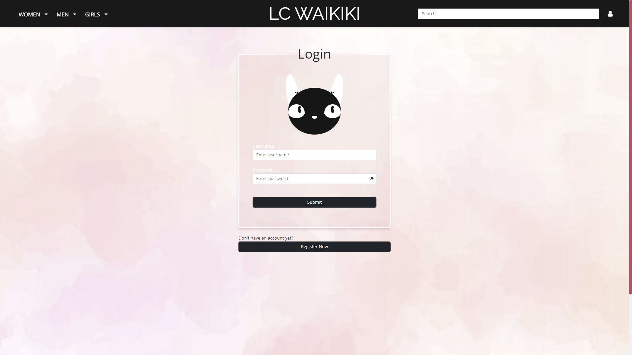

E-Shop Redesign
Jana Trpkovska Stefanija Filipasikj

Slide 2
Product List

Slide 3

Product List
Card Layout for Product Display:
Showcases products in visually appealing cards.
Hover-Activated Image Preview:
Hover over a product to view multiple images.
Flexible Card Grid:
Choose to display 1, 3 or 4 cards per row.
Collapsible Filter Sidebar:
Easily toggle the filter sidebar.
Clickable Product Cards:
Click on a product card to view detailed information.

Slide 4
Product Details

Slide 5
Filters – Category, Price, Color and Custom
Category Filter:
Located in the header, allows users to filter products by gender and clothing category.
Price Filter:
Allows users to filter products by price range. Uses a slider component from MUI.
Color Filter:
Allows users to filter products by available color options.
Custom Filter:
Lets users build the piece of clothing by choosing the neckline, length, waist, sleeves… and then filters the products that match the drawing.
Implemented with transparent drawings of sleeve options, neckline options… that are placed on top of each other.

Slide 6
Filters

Slide 7
Product Details
Color Options:
Allows users to select their preferred color option of the clothing item.
Multiple Images:
Displays multiple images corresponding to the selected color option.
Product Details:
Expandable section showing details such as fabric, fit, patters etc.
Washing Instructions:
Expandable section with washing instructions for the clothing item.
Add to Cart:
Enables users to choose the size and quantity, then add the clothing item to their cart.

Slide 8
Shopping Cart and Order

Slide 9
Shopping Cart & Order
Cart Item Cards:
Displays clothing items with their image, title, size and quantity.
Edit Cart Items:
Allows users to adjust the size and quantity of items directly in the cart.
Delete Cart Items:
Provides an option to remove items from the cart.
Order Summary:
Shows the total item count and total price of products in the cart.
Place Order:
Enables users to proceed with placing an order for the items in their cart.

Slide 11
User Authentication And Home Page
Login & Register:
Login enables users to securely sign into their accounts.
Register allows new users to create an account effortlessly.
Animated Blinking Cat:
Features a SCCS animation from CodePen, enhanced with JavaScript to close the cat’s eyes when entering a password.
Photo Grids and Carousel:
Showcases the latest collection and popular clothing items in a visually appealing layout.
Icons:
Highlights store benefits like Fast Shipping, Free returns, customer support etc – implemented with SVG.

Slide 12
Made with:
Spring Boot
React
Bootstrap
CSS
SCSS
MUI
SVG

